Slide 1
PHASE 18 • KEY-DRIVER PRIORITIZATION
From run-level KDA evidence to a focused key-driver atlas
Selection logic • cross-network recurrence • evidence breadth • descriptive sex/APOE patterns
MT drivers and non-MT drivers are ranked separately within seven broad cell-network models.
Prepared from validated Phase 18 outputs • 16 August 2026

Slide 2
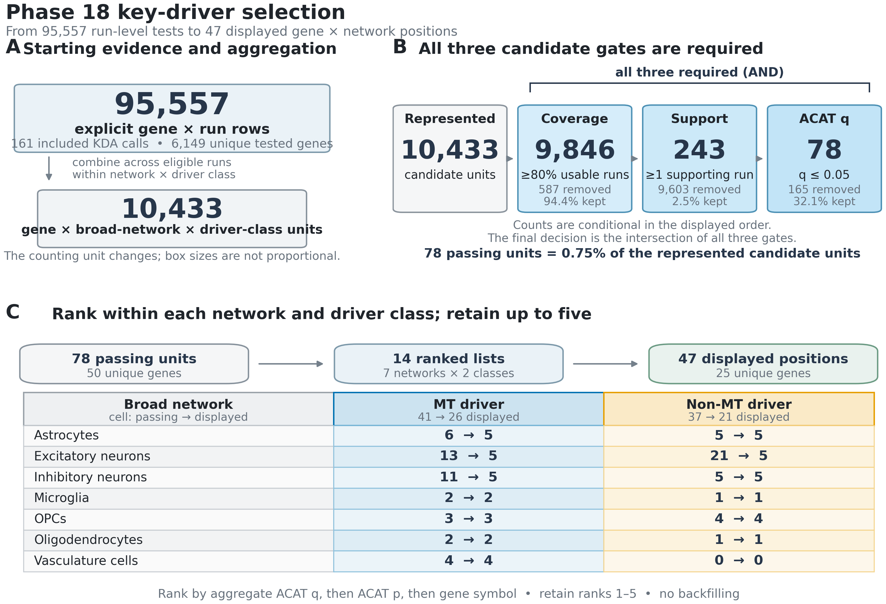
SELECTION PROCESS
02
A strict intersection of coverage, support, and aggregate evidence
The pipeline changes counting units as run-level tests are aggregated into network × driver-class candidates.
What earns a place
All three gates are required: ≥80% usable-run coverage, ≥1 conservative-support run, and aggregate ACAT q ≤ 0.05.
The intersection retains 78 of 10,433 represented candidate units (0.75%).
Candidates are ranked independently in 14 lists: 7 broad networks × 2 driver classes.
Ranks 1–5 are displayed with no backfilling when fewer candidates pass.
47
25
displayed gene × network positions
unique displayed genes
Prioritization—not proof of causal regulation.
Source: phase18_key_driver_selection_process.png and accompanying validated caption/methods

Slide 3
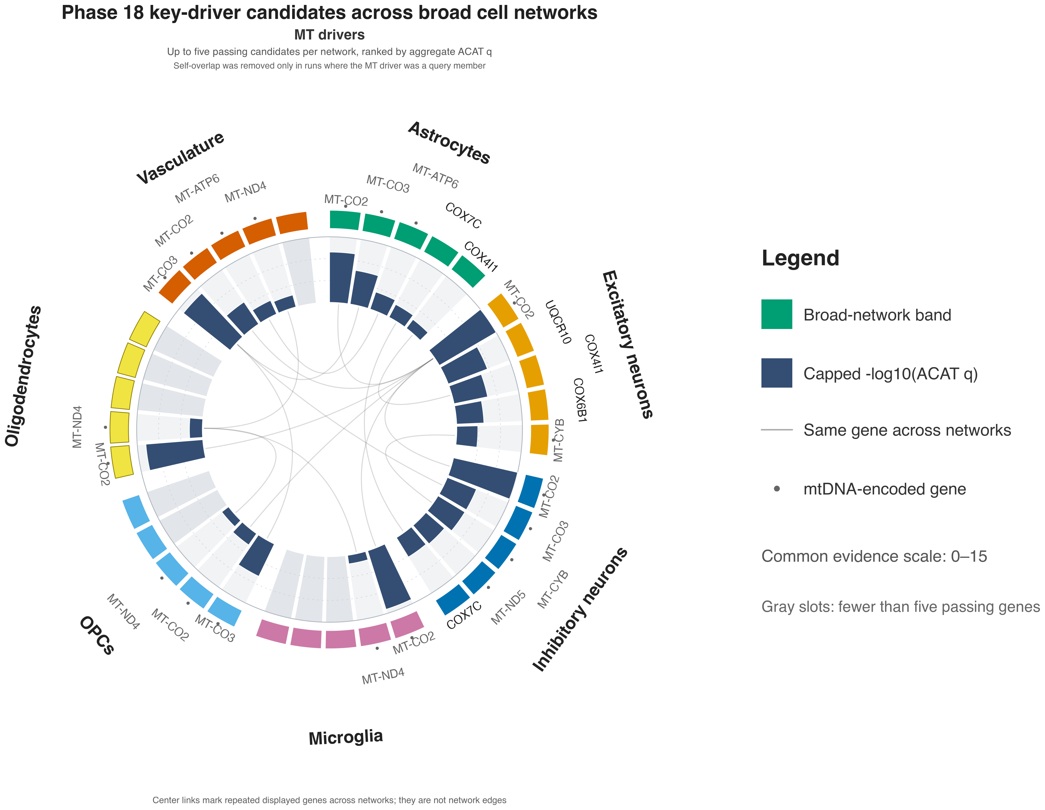
MT view: 10 genes occupy 26 displayed positions; MT-CO2 recurs in 7 of 7 networks, while gray slots preserve lists with fewer than five passers.
Source: phase18_mt_driver_circular.png • center curves show recurrence, not network edges

Slide 4
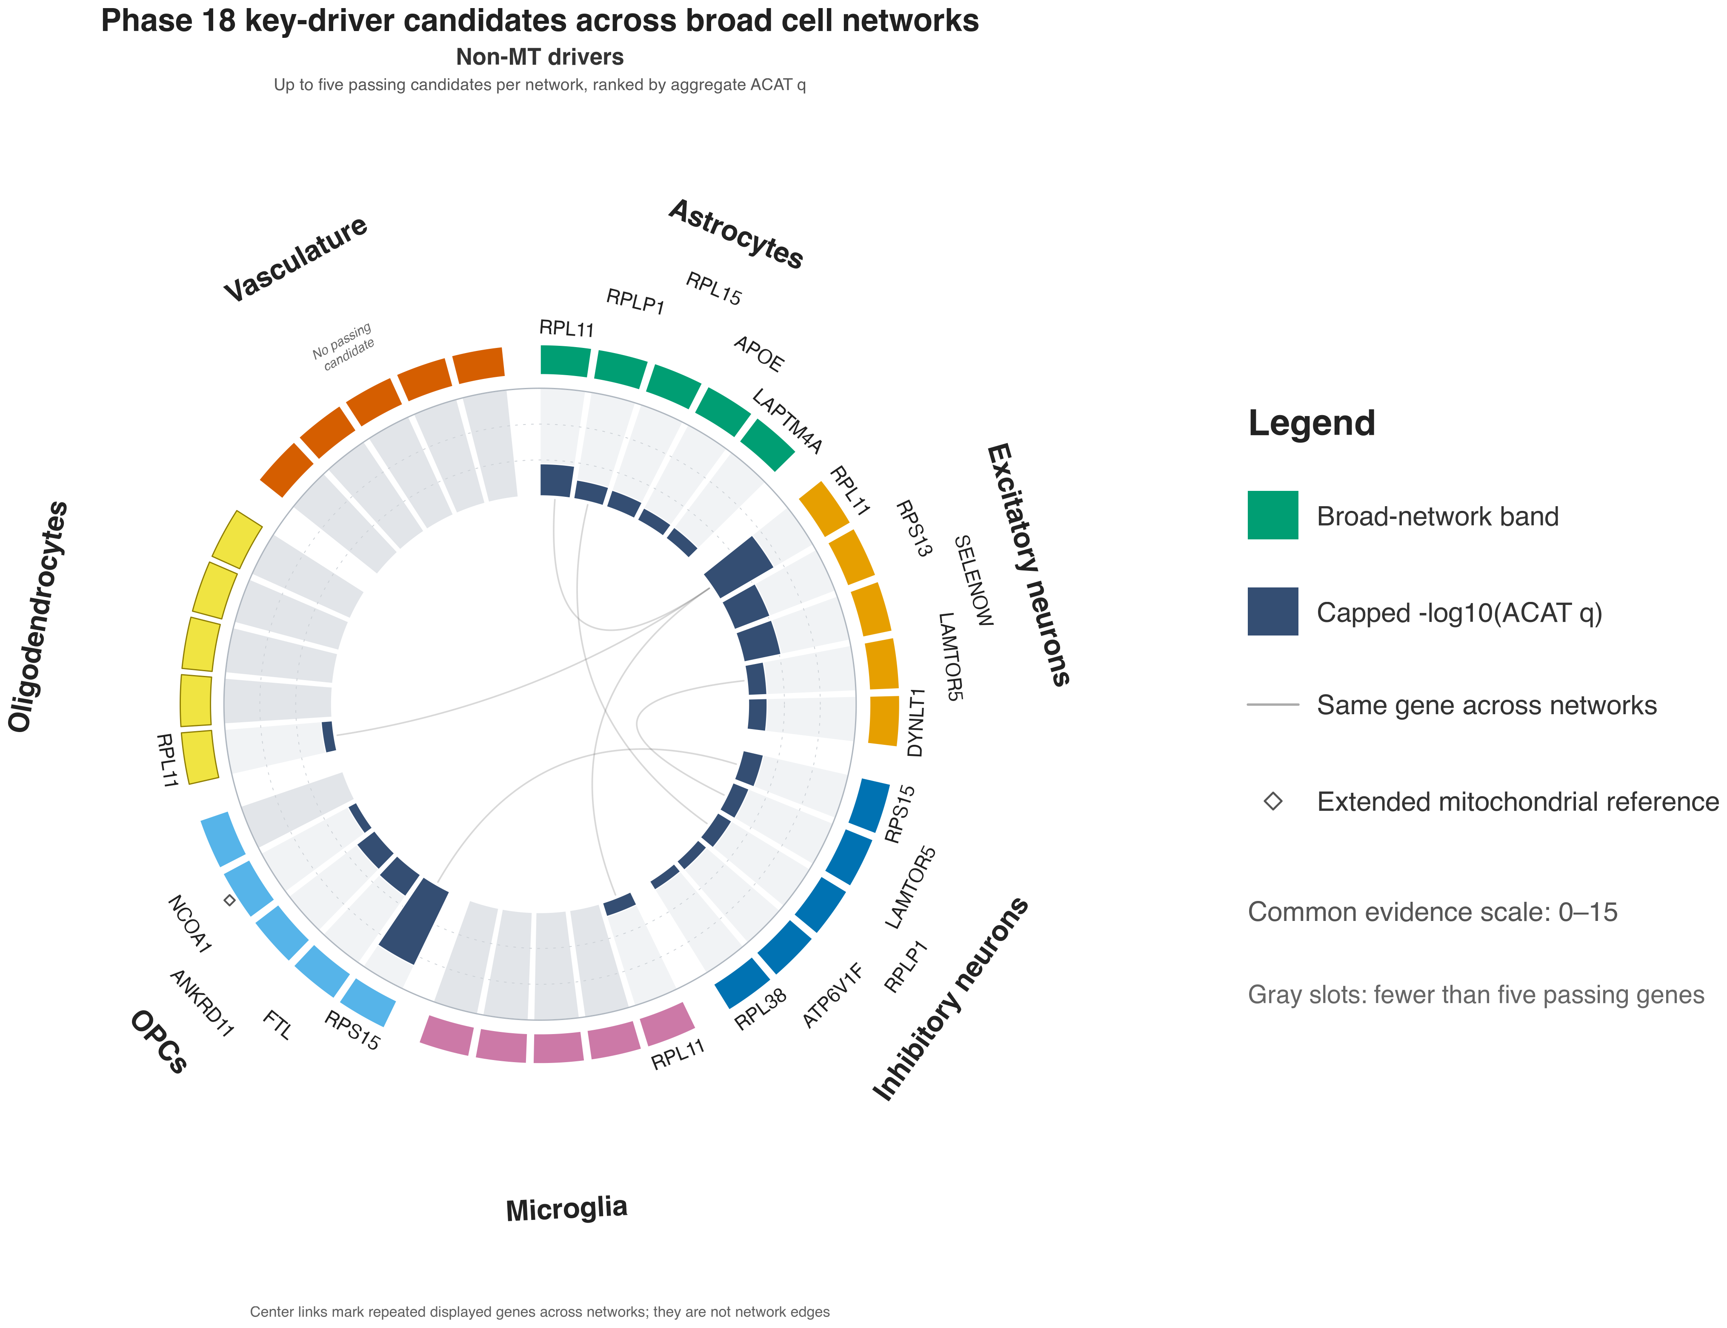
Non-MT view: 15 genes occupy 21 displayed positions; RPL11 recurs in 4 networks, and vasculature has no passing non-MT candidate.
Source: phase18_non_mt_driver_circular.png • non-MT means outside core MitoCarta, not absence of mitochondrial function

Slide 5
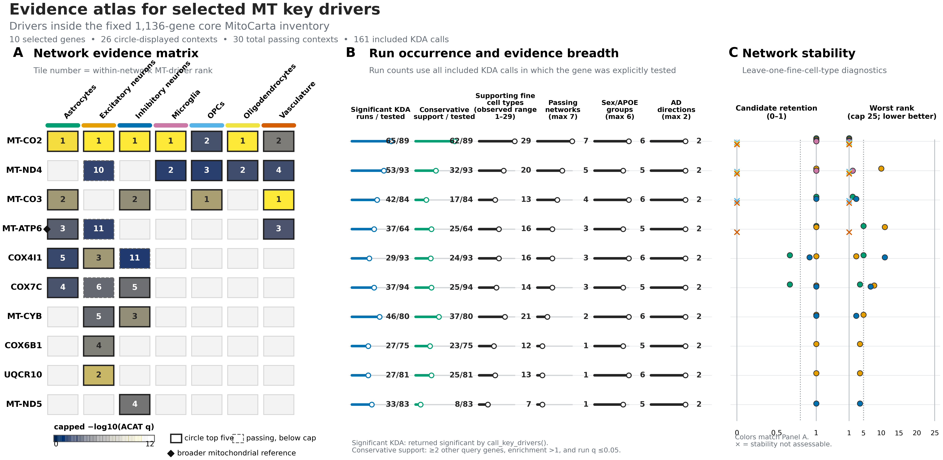
MT evidence is broadest for MT-CO2: 62/89 conservative-support runs, 29 fine cell types, all 7 networks, all 6 primary groups, and both AD directions.
Source: phase18_evidence_atlas_mt.png • stability is diagnostic and did not determine selection

Slide 6
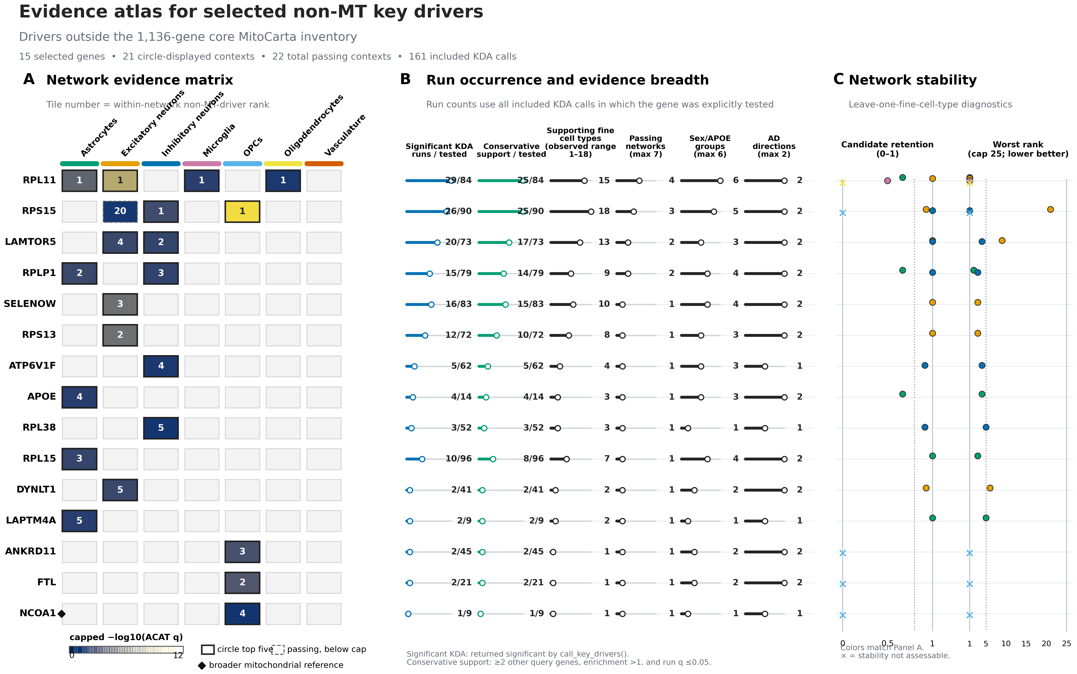
EVIDENCE ATLAS • NON-MT
06
Ribosomal candidates carry the broadest non-MT evidence
Network evidence, recurrence, breadth, and leave-one-fine-cell-type stability are complementary summaries.
Presentation readout
RPL11 passes in 4 networks with 25/84 conservative-support runs across 15 fine cell types.
RPS15 has the widest non-MT fine-cell breadth (18) and passes in 3 networks.
The dashed RPS15 excitatory-neuron tile passed selection but ranked below that network's five-gene display cap.
RPL/RPS genes recur across networks; LAMTOR5 spans excitatory and inhibitory networks; APOE is astrocyte-localized.
The top-five rule is a display cap—not an evidence threshold.
Source: phase18_evidence_atlas_non_mt.png and gene summary TSV

Slide 7
SYNTHESIS
07
What Phase 18 establishes—and what it leaves open
The broad atlas establishes which candidates emerged; the next slides localize support before the RPL11 case study.
Selection
MT landscape
Non-MT landscape
78 passing units become 47 displayed network positions across two separately ranked driver classes.
Respiratory-chain genes dominate recurrence; MT-CO2 is the clearest cross-network sentinel.
Ribosomal candidates lead breadth and recurrence, with additional signaling, trafficking, and APOE-linked hypotheses.
Interpretive boundary: the figures prioritize network-associated key-driver candidates and show where evidence recurs. They do not prove causality or formally test sex/APOE interactions.
Next: localize candidate evidence across sex/APOE strata, then examine RPL11 in depth.
Slide 10 introduces the validation panel; slides 11–16 extend the atlas with the RPL11 pathway and STRING figures

Slide 8
SEX/APOE EVIDENCE • MT
08
MT support is widespread but uneven across descriptive strata
Each row is a gene × broad-network context; columns partition AD-up and AD-down queries by sex and APOE group.
How to read the matrix
Dot area = fraction of usable queries with conservative support; fill = capped −log10(stratum ACAT P).
Small open circles mean usable tests with zero conservative support; dashes mean no eligible query.
The right tracks report official network-level q, support/usable, coverage, evidence tier, and rank.
Descriptive pattern
AD-up female ε3/ε3: 68 supporting runs across 15 contexts
AD-down male ε2: 65 supporting runs across 30 contexts
AD-up female ε2: 63 supporting runs across 15 contexts
These are not formal sex, APOE, or interaction tests.
Source: phase18_sex_apoe_mt.png • supporting-run totals are descriptive across displayed contexts

Slide 9
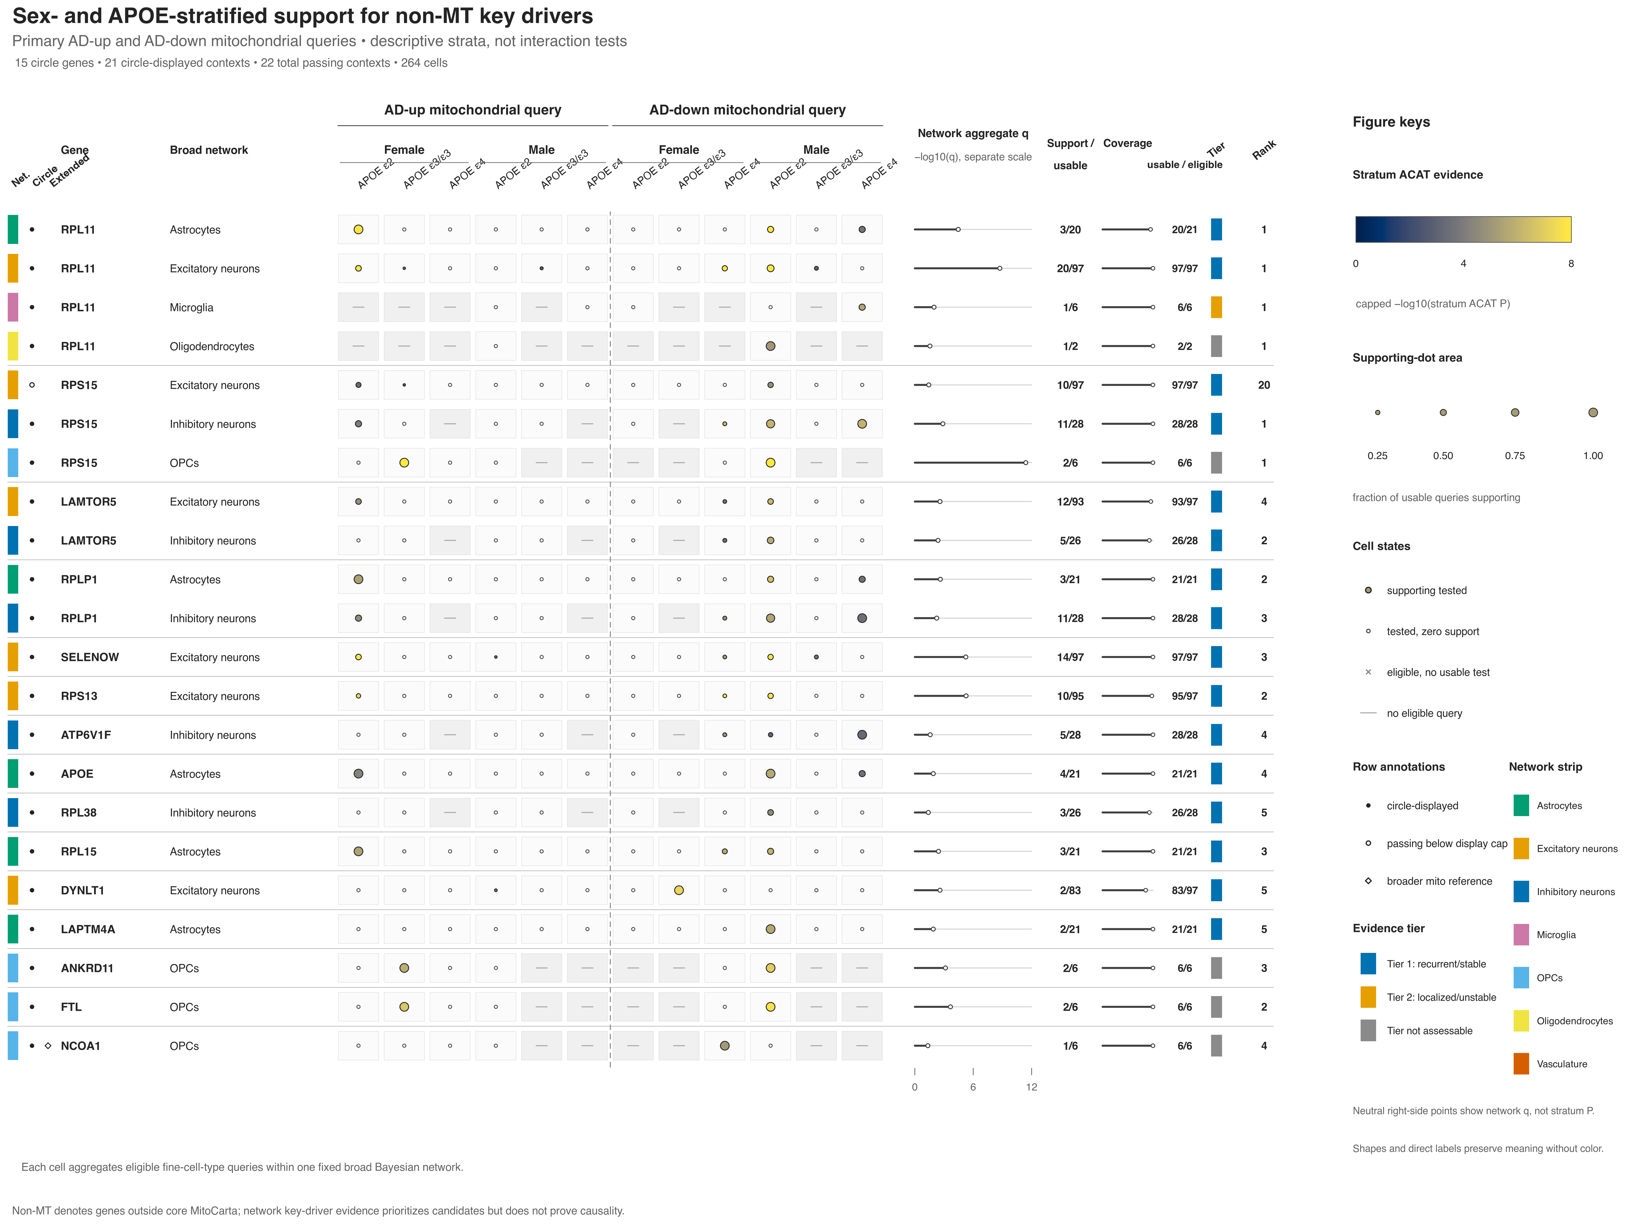
SEX/APOE EVIDENCE • NON-MT
09
Non-MT support concentrates in a smaller set of strata
The same visual grammar reveals broad recurrence for some drivers and sharply localized evidence for others.
Leading patterns
AD-down male ε2: 62 supporting runs in 19 contexts
AD-up female ε2: 28 supporting runs in 11 contexts
AD-down female ε4: 16 supporting runs in 10 contexts
AD-down male ε4: 10 supporting runs in 7 contexts
Candidate examples
RPL11 is recurrent across four networks; RPS15 is broad across neuronal/OPC contexts; APOE is localized to astrocytes. Large dots with small denominators should not be mistaken for broad replication.
Patterned evidence generates hypotheses; it does not establish specificity.
Source: phase18_sex_apoe_non_mt.png • descriptive totals match the validated figure guide

Slide 10
FIRST-BATCH VALIDATION PANEL
10
Why these six candidates go first
A purposeful pilot panel—not the six smallest q values—balances calibration, mechanism, cell type, and failure-mode testing.
POSITIVE CONTROL
ASTROCYTES
REINFORCED
EXCITATORY
CROSS-NETWORK
EXCITATORY + INHIBITORY
APOE
SELENOW
LAMTOR5
Known AD biology calibrates the workflow. The discovery test is whether its frozen astrocyte mitochondrial target module reproduces—not whether APOE is an AD gene.
Stable excitatory KDA plus direct AD-model tau-clearance and redox/respiration evidence makes it the externally reinforced mechanism.
Recurrence in two neuronal networks provides a tractable lysosome–Ragulator–mTORC1 route to mitochondrial regulation.
BIAS TEST
4 NETWORKS
EXPLORATORY
OPCS
NOVELTY TEST
OPCS
RPL11
FTL
ANKRD11
Broadest recurrent non-MT signal—and the hardest specificity test. It advances only if it beats expression-, degree-, and ribosomal-class matched nulls.
Iron storage/ferroptosis is plausible in OPCs, but support is sparse (2 runs, 1 subtype). Independent localization and replication come first.
An orthogonal chromatin-regulation hypothesis tests whether a novel OPC mechanism reproduces. Sparse subtype evidence keeps it exploratory.
Unequal priors by design: APOE calibrates; SELENOW, LAMTOR5, and RPL11 carry stronger support; FTL and ANKRD11 must replicate before promotion.
Source: Phase 18 call_key_driver_returns.tsv and phase18_key_driver_cross_validation_guide.md, Section 2

Slide 11
11
RPL11 DEEP DIVE
A ribosomal-stress candidate at the translation–mitochondria interface
Mechanistic model
Free RPL11 can inhibit MDM2 and activate p53; neuronal ribosomal stress can require RPL11 for p53-linked cell death.
RPL11 is the broadest non-MT network candidate, but the mechanistic claim depends on distinguishing a true stress transducer from a highly connected module marker.
RPL11 transmits stress into mitochondrial and survival programs.
4
29/84
25
15
Module-marker model
passing broad networks
significant / tested runs
conservative-support runs
supporting fine cell types
RPL11 may inherit strong KDA and STRING signals from high expression, ribosomal connectivity, or a general disease/quality response.
Human context
AD capillary proteomics reported increased RPL11/RPL15 protein, while earlier AD work supports ribosomal dysfunction. The capillary signal does not establish neuronal or astrocytic localization.
Target specificity and matched ribosomal nulls decide between the models.
Biological discussion: phase18_key_driver_gene_by_gene_initial_analysis.md • Zhang 2003; Slomnicki 2018; Suzuki 2022; Ding 2005

Slide 12
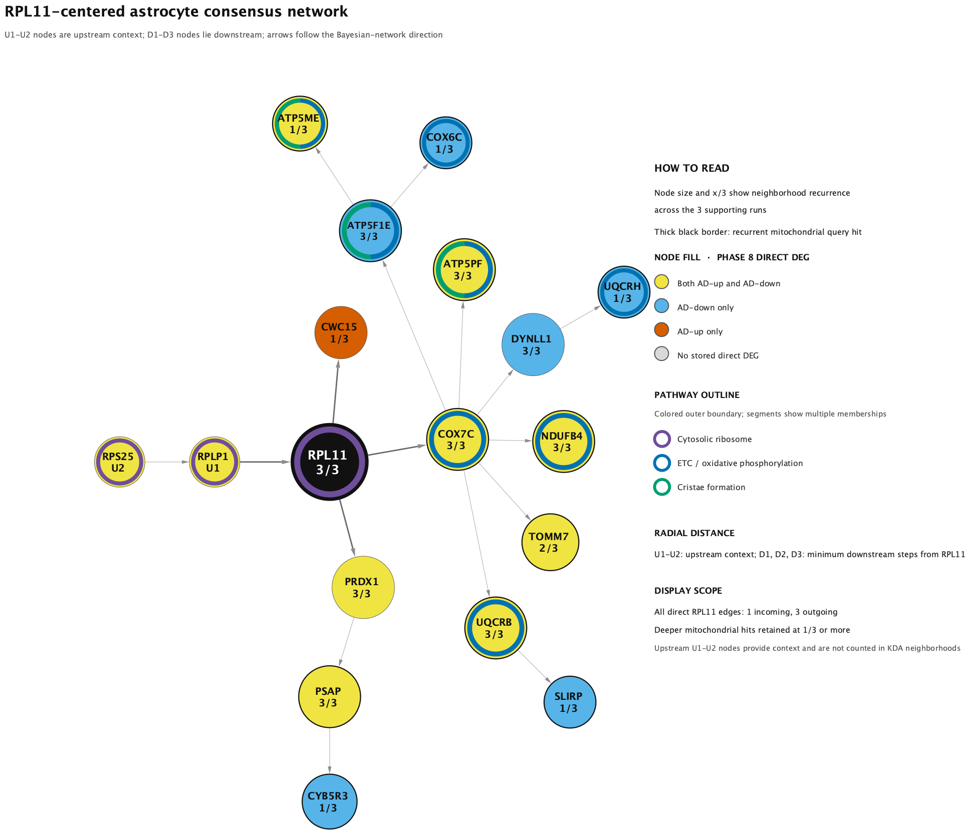
RPL11 • ASTROCYTES
12
A focused respiratory branch emerges from three supporting runs
Directed Bayesian-network edges are model-derived regulatory hypotheses; pathway outlines summarize the displayed genes.
Evidence scale
3/20
3.44×10⁻⁵
supporting / usable astrocyte runs
aggregate ACAT q
Network readout
18 nodes, 17 directed edges, and 12 mitochondrial query hits.
Upstream chain: RPS25 → RPLP1 → RPL11. Direct outputs: COX7C, CWC15, and PRDX1.
ETC/OXPHOS: 8 genes, BH FDR 1.98×10⁻⁸. Cristae formation: 3 genes, FDR 0.00475.
The ribosome outline is contextual (FDR 0.0805), not significant at 0.05.
Interpretation: a reproducible but relatively small astrocyte signal connects RPL11 to a coherent respiratory/cristae branch.
Source: phase18_rpl11_astrocyte_consensus_network_pathways.png, caption, methods, and ORA table

Slide 13
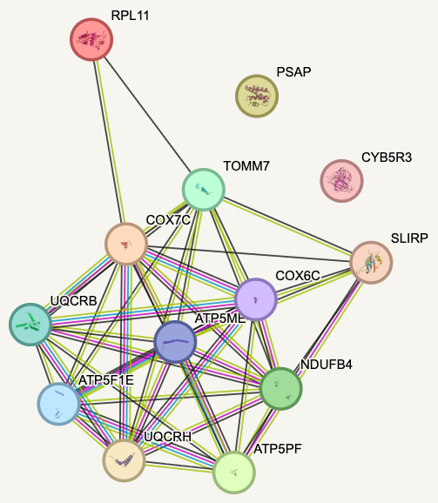
RPL11 • ASTROCYTES
13
STRING supports target-module coherence more clearly than direct regulation
Medium-confidence STRING functional associations are undirected and are not astrocyte- or AD-specific.
What the image supports
The respiratory targets form a dense protein-association core spanning complex I, III, IV, and V proteins.
RPL11 is sparsely connected relative to the target-to-target core; PSAP and CYB5R3 remain visually isolated in this view.
The visual density therefore supports a coherent mitochondrial module, but it cannot by itself show that RPL11 regulates that module.
Claim boundary
A direct RPL11 claim requires the input-only physical network, edge-level experimental/curated evidence, a ≥0.700 threshold, and matched ribosomal/topology controls. Until then, the medium-confidence figure is suggestive module-level cross-validation.
Allowed conclusion: protein-level coherence of the target module; direct RPL11 support remains provisional.
Source: astrocyte/string_full_medium_conf.png • interpretation follows rpl11_astrocyte_string_analysis_guide.md

Slide 14
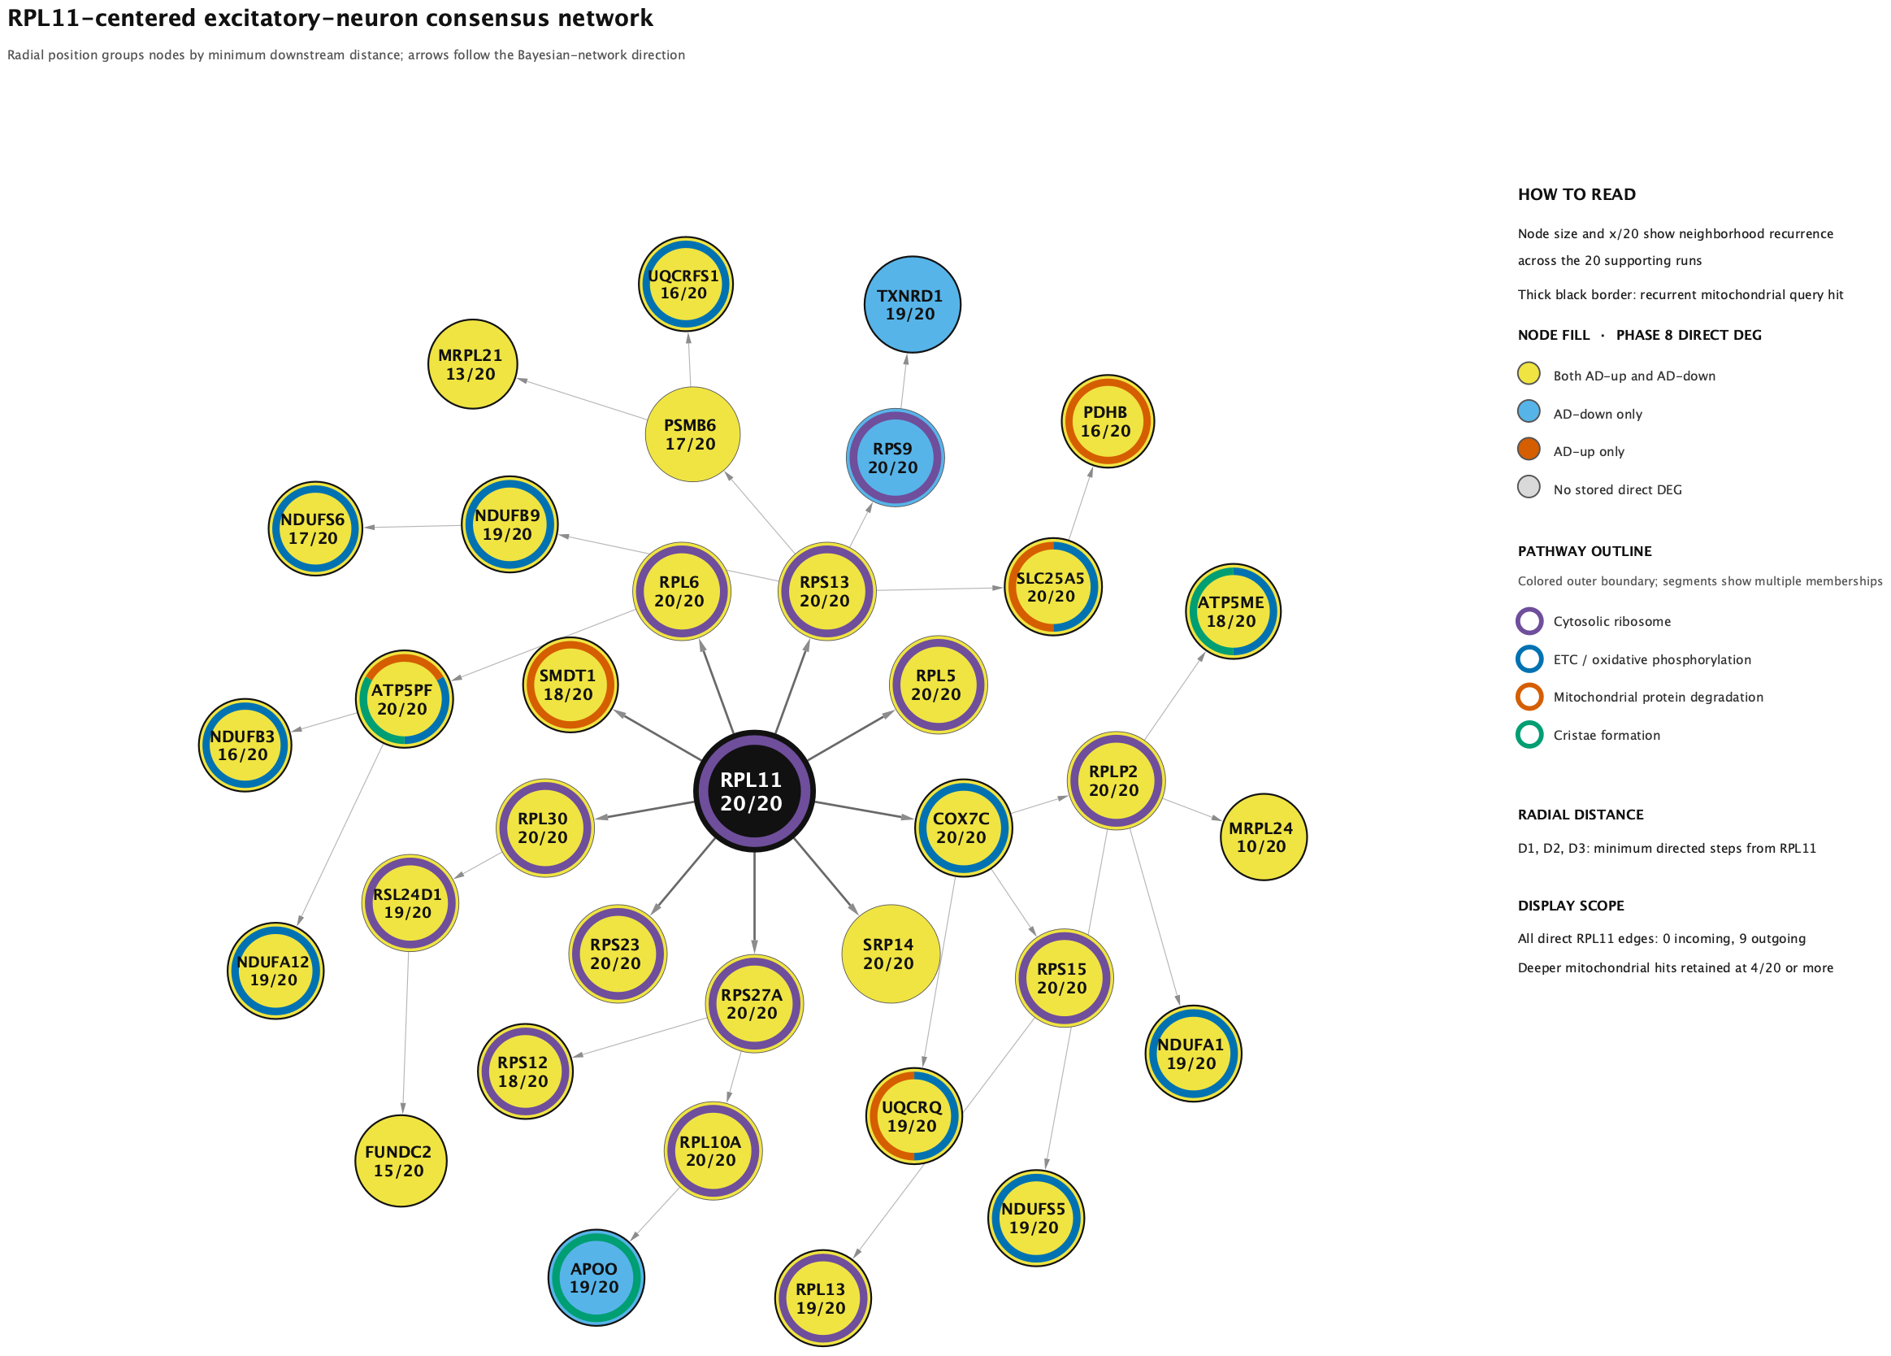
RPL11 • EXCITATORY NEURONS
14
A broader translation–mitochondria interface recurs across 20 runs
The excitatory context has stronger aggregate evidence and complete leave-one-fine-cell-type candidate retention.
Evidence scale
20/97
1.84×10⁻⁹
supporting / usable excitatory runs
aggregate ACAT q
Network readout
35 nodes, 34 directed edges, 21 mitochondrial query hits, and 9 direct RPL11 outputs.
Direct outputs include ribosomal proteins plus COX7C and SMDT1, creating a model-derived bridge to mitochondrial functions.
Cytosolic ribosome: 14 genes, FDR 1.35×10⁻¹⁶; ETC/OXPHOS: 12 genes, FDR 3.20×10⁻¹³.
Mitochondrial protein degradation (FDR 0.00180) and cristae formation (FDR 0.00762) add proteostasis/structure hypotheses.
Interpretation: the excitatory signal is broader and more recurrent, but its ribosomal density makes specificity controls essential.
Source: phase18_rpl11_excitatory_consensus_network_pathways.png, node/edge tables, and ORA table

Slide 15
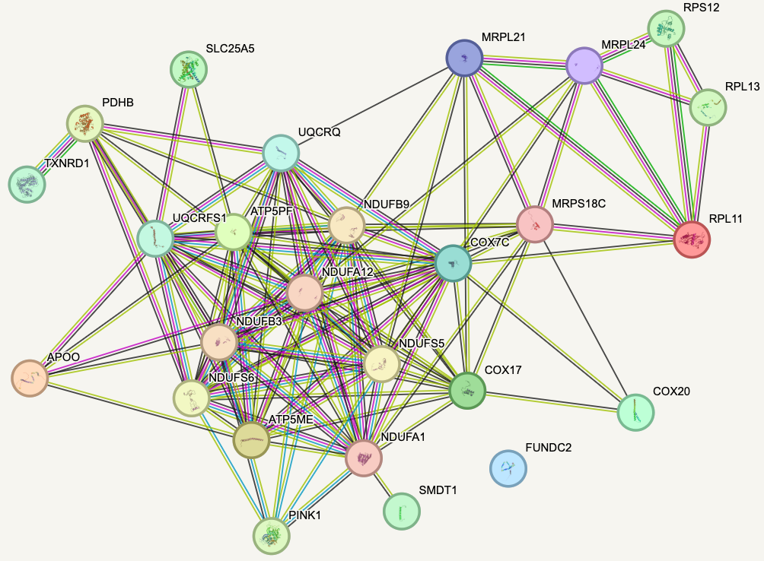
RPL11 • EXCITATORY NEURONS
15
STRING resolves ribosomal and respiratory protein neighborhoods
The displayed functional network is useful for architecture; it does not preserve Bayesian edge direction.
Architecture
RPL11 sits with cytosolic/mitochondrial ribosomal proteins, while the respiratory proteins form a dense OXPHOS core.
The view is consistent with a ribosome–mitochondria interface rather than one simple RPL11→target protein chain.
Respiratory-protein density is expected and can dominate whole-network PPI enrichment.
Exploratory elements
MRPS18C, COX17, COX20, and PINK1 appear as STRING-side connectors rather than prespecified Bayesian-consensus nodes. They are mechanism hypotheses—not validation endpoints.
Test RPL11-to-target edges separately from target-to-target connectivity.
Source: excitatory/full_medium_conf.png • medium-confidence functional STRING view

Slide 16
RPL11 SYNTHESIS
16
The excitatory signal is broader; the astrocyte signal is more focused
Both contexts support a translation/stress-to-mitochondria hypothesis, while leaving target specificity unresolved.
ASTROCYTES
EXCITATORY NEURONS
Focused respiratory branch
Broad translation–mitochondria interface
3/20 supporting runs; aggregate q 3.44×10⁻⁵.
20/97 supporting runs; aggregate q 1.84×10⁻⁹.
18-node directed consensus with ETC/OXPHOS and cristae enrichment.
35-node consensus combines ribosome, OXPHOS, cristae, and mitochondrial proteostasis.
STRING shows a dense target core but comparatively sparse RPL11 connectivity.
STRING separates a ribosomal neighborhood and dense respiratory core with exploratory connectors.
Best current framing: focused, plausible, and still in need of protein-edge/null validation.
Best current framing: stronger recurrence, but higher risk of generic ribosomal-module effects.
DECISIVE VALIDATION
Match for expression, degree, neighborhood size, and ribosomal class → use partial CRISPRi/CRISPRa in APOE-isogenic astrocytes and excitatory neurons → measure predicted MT targets, p53, nascent translation, respiration, and viability → add p53 inhibition/rescue and spatial/vascular proteomics.
Interpretation and validation priorities synthesized from phase18_key_driver_gene_by_gene_initial_analysis.md

